Slide 1
Cannabis Law & the Cannabis Lawyer
Cannabis Practice Group
September 21, 2022

Slide 2
Cannabis Practice Group & Presenters
Eric Sleeper
Partner, Barton LLP
Carrie Ward
Shareholder, Earp Cohn P.C.
Michelle Mabugat
Counsel, Greenberg Glusker Fields Claman & Machtinger LLP

Slide 3
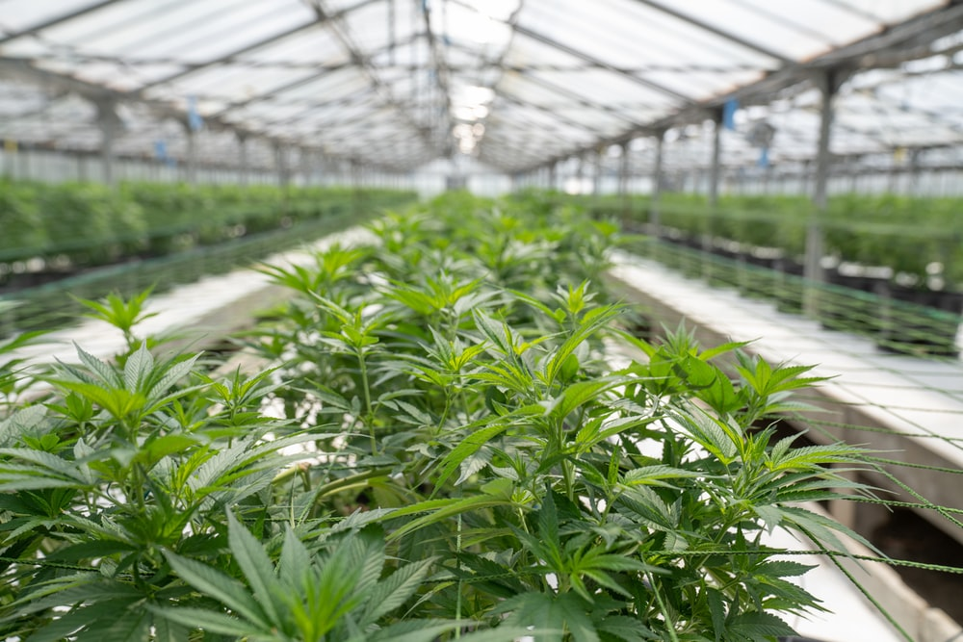
Why a Cannabis Practice Group?
Huge commercial growth in less than a decade
Worldwide sales of legalized marijuana alone topped $21 billion in 2020; projections show market growth rising above $100 billion by 2028
There has been an equally rapid growth of cannabis ancillary businesses and accessory products, including those infused with CBD, CBG, and/or CBN or developed through the cultivation of hemp with its ever increasing commercial and industrial uses
A very broad-based industry:
Plant-touching cannabis businesses –
Cultivators
Lab Testers
Manufacturers
Distributors
Retailers/Dispensaries
Delivery Services
On-Site Cannabis Consumption Lounges

Slide 4
Why a Cannabis Practice Group? (cont’d)
Non-touch ancillary/accessory businesses – numerous and growing annually; don’t face the licensing and regulatory hurdles of plant-touching companies; but offer the types of products and services that both cannabis and non-cannabis businesses and everyday people engage with regularly
Environmental
Construction
Packaging
Security
Marketing
Technology
Numerous Accessory Products
Infused Products (CBD, CBG, CBN)
Hemp-Based Products
Psychedelics

Slide 5
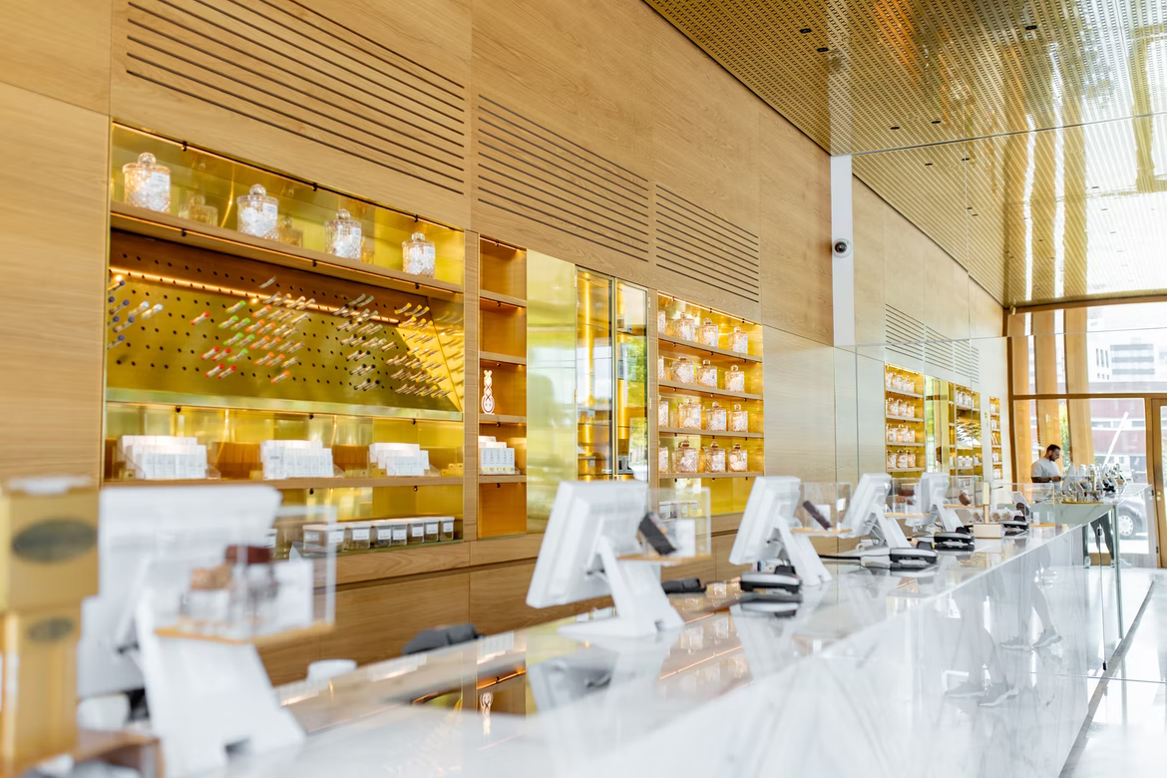
Diverse, Multi-Disciplinary Legal Services
Corporate
Corporate formation and structure
Public companies and SEC and other agency filings
Capital formation activities
Mergers and acquisitions
Partnership and operating agreements
Domestic and cross-border financing and merger and acquisition transactions

Slide 6
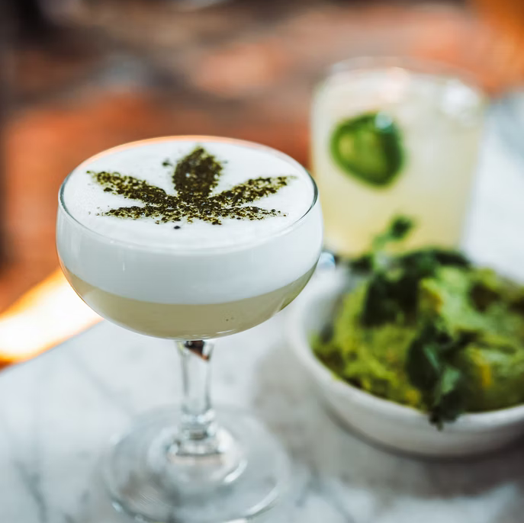
Diverse, Multi-Disciplinary Legal Services (cont’d)
Litigation
Civil matters, such as breach of commercial contracts or fraud/ misrepresentation
Products liability/manufacturing defects
Trademark and patent infringement
Employment-related claims

Slide 7
Diverse, Multi-Disciplinary Legal Services (cont’d)
Taxation
General planning and advice
IRS Section 280E
Real Estate and Construction
Zoning and land use
Leasing and landlord/tenant matters
Intellectual Property
Trademarks and patents
Licensing agreements
Marketing and branding
Health Law
Hospital compliance; HIPAA
Labor and Employment
Workplace training
Non-compete
Executive employment agreements
Insurance
Cybersecurity
Financial Restructuring and Bankruptcy
Information Technology and Management Software
Environmental Considerations

Slide 8
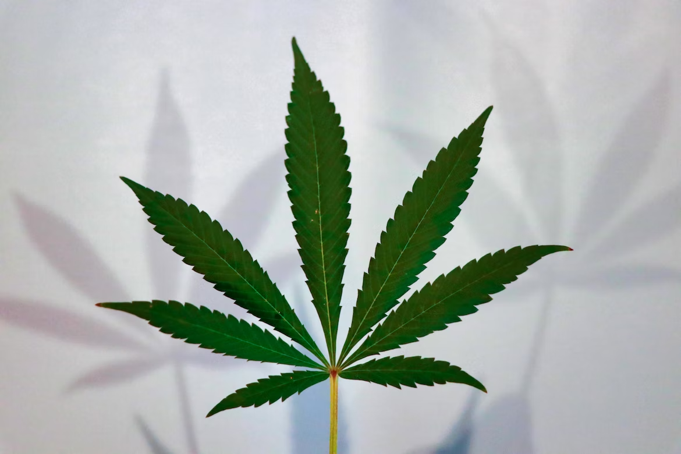
Cannabis Resources
U.S. Federal Cannabis Laws Generally
U.S. State Cannabis Laws Generally
U.S. State Cannabis Laws Generally
Cannabis Law Generally
International Laws & Markets
Online Magazines
Books
Cannabis Law Blogs

Slide 9
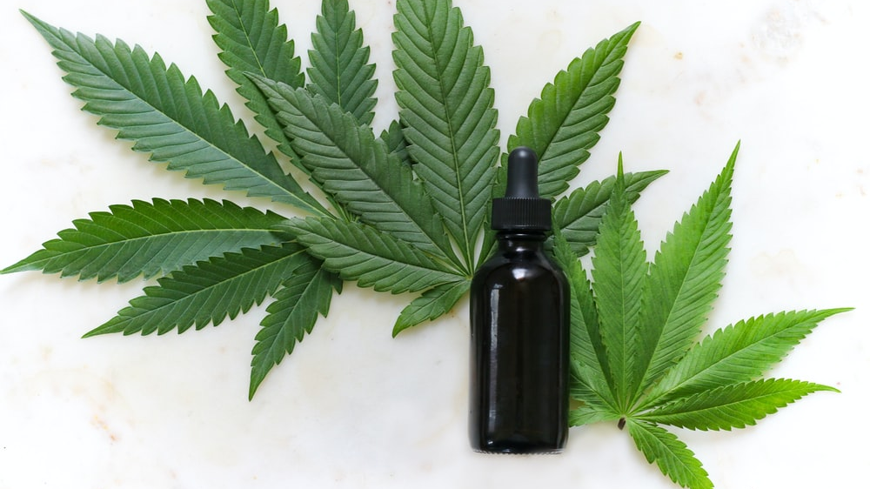
Questions?

Slide 10
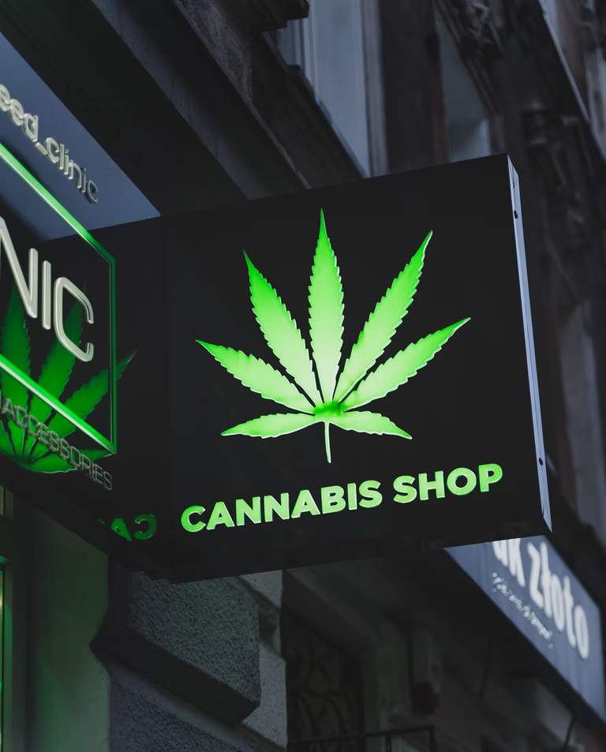
Eric Sleeper
Partner, Barton LLP
esleeper@bartonesq.com
bartonesq.com
Office: 212-687-6262
Cell: 609-203-5788
Carrie Ward
Shareholder, Earp Cohn P.C.
cward@earpcohn.com
earpcohn.com
Office: 856-354-7700
Michelle Mabugat
Counsel, Greenberg Glusker Fields Claman & Machtinger LLP
mmabugat@greenbergglusker.com
greenbergglusker.com
Office: 310-785-6845

